Slide 1
Assessing the Spatiotemporal Variability of Precipitable Water Vapour in Africa using Data Analytics
by
Martin Aborgeh and Jennifer Yawa Lavoe
Supervised by
Dr Samuel Osah
Notes:
Avoid uppercases
Try to give brief (40secs) overview of the research by mentioning the problem

Slide 2
Outline
Background information
Problem Statement
Research, Aim and Objectives
Research gap
Proposed Methodology and Data Analysis
Supplication and Implication
Conclusion
Notes:
Recommendations must come from the conclusion and can associated to limitation of the study
Recommendations must direct your research for suture studies
Recommendations should also dwell on policy issues

Slide 3
Background Information
Africa has diverse climatic zones, including tropical rainforests, savannas, deserts, and Mediterranean climates, influenced by atmospheric phenomena such as the Intertropical Convergence Zone (ITCZ), African Easterly Jet (AEJ), and the Saharan Air Layer
Climate change studies in Africa indicate increasing temperatures, altered rainfall patterns, and changes in the frequency and intensity of extreme weather events, which have significant implications for agriculture, water resources, and ecosystems in the region
Tropospheric delay, influenced by factors like water vapor content and temperature, affects satellite signals passing through the atmosphere, and Precipitable Water Vapor (PWV) is an important atmospheric parameter representing the total amount of vertical column water vapor in the atmosphere
Various methods, including ground-based weather stations, radiosondes, satellite observations, remote sensing techniques, and GNSS receivers, are used to collect atmospheric data
Spatiotemporal assessment of GNSS (Global Navigation Satellite System) Zenith Total Delay (ZTD) and PWV data in involves data analytics, modeling, and predictions, contributing to improved climate predictions, impact assessments, and decision-making related to climate change

Slide 4
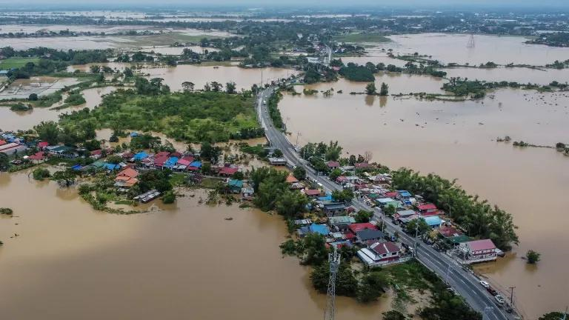
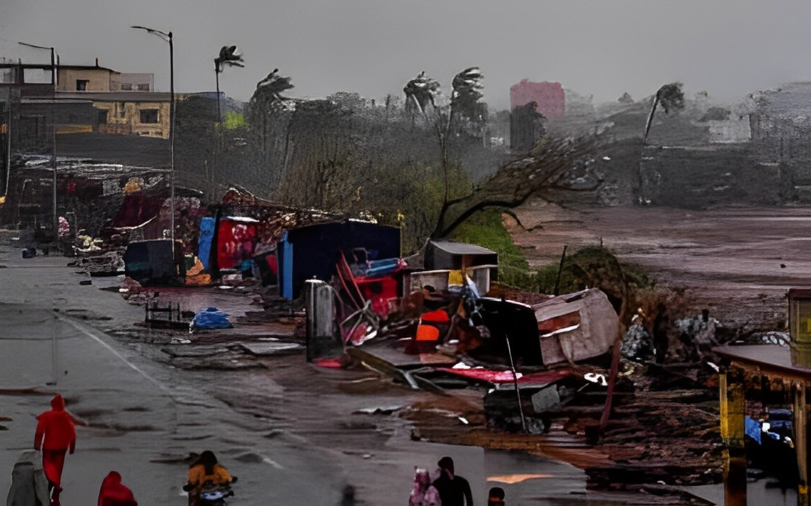
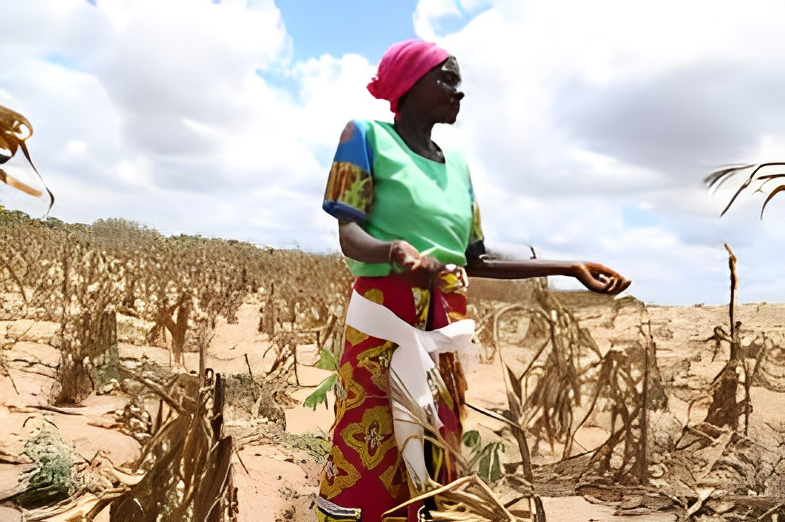
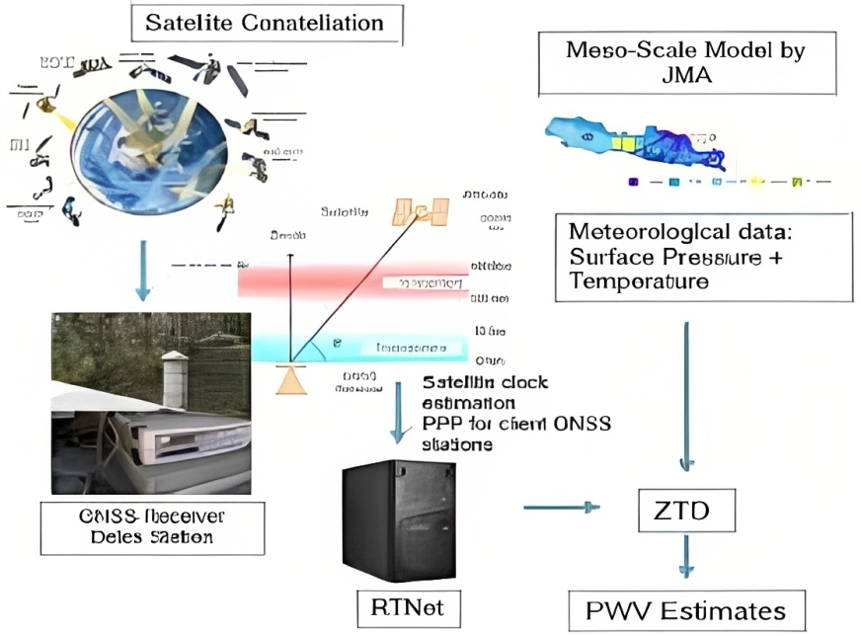
Problem Statement
Impact of Flood
Impact of Cyclones
Impact of Drought
The need for PWV study

Slide 5
Aim and objectives
Aim
The aim is to analyze the spatiotemporal variability of GNSS and ERA5 derived Precipitable Water Vapour across Africa.
Specific Objectives (SO) | Questions
To Retrieve Precipitable Water Vapour values from ground-based(GNSS ZTD) and Numerical models(ERA5) | How is Precipitable Water Vapour obtained?
To forecast Precipitable water vapour using ensemble and Time Series models | What algorithms and tools are used in the Prediction of precipitable water vapour?
To assess the spatiotemporal characteristics of Precipitable Water Vapour in Africa using time series and spatial models. | How is the Spatial and temporal Variation of PWV differ across Regions in Africa

Slide 6
Research Gap
Previous research on PWV estimation, analysis, and prediction has primarily focused on countries from various continents such as Iran, China, North America, Australia, Europe, and Alaska. Some studies have also been conducted in African countries like Ghana(A. A. Acheampong et al., 2017), Nigeria(Abimbola & Falaiye, 2016); Mozambique, Angola, and Nigeria (Fernandes et al.,2022), West Africa((A. Acheampong & Obeng, 2019).However, a comprehensive study covering the entire continent of Africa is lacking.
Researchers have employed various models, including Support Vector Regression, Random Forest, LS-SVR, XGBoost, and Neural Networks, among others, to analyze and predict PWV patterns and trends
While Models such as LS-SVR, XGBoost , NN have shown promising results in reviewed papers, the combination of them(LS-SVR, XGBoost), and Neural Networks in an ensemble model for PWV assessment has not been extensively explored . Therefore, the current work purport to utilize these individual models as base models in ensemble models to predict PWV values in Africa with an improvement in the volume of data used in training the model as recommended by most researchers.

Slide 7
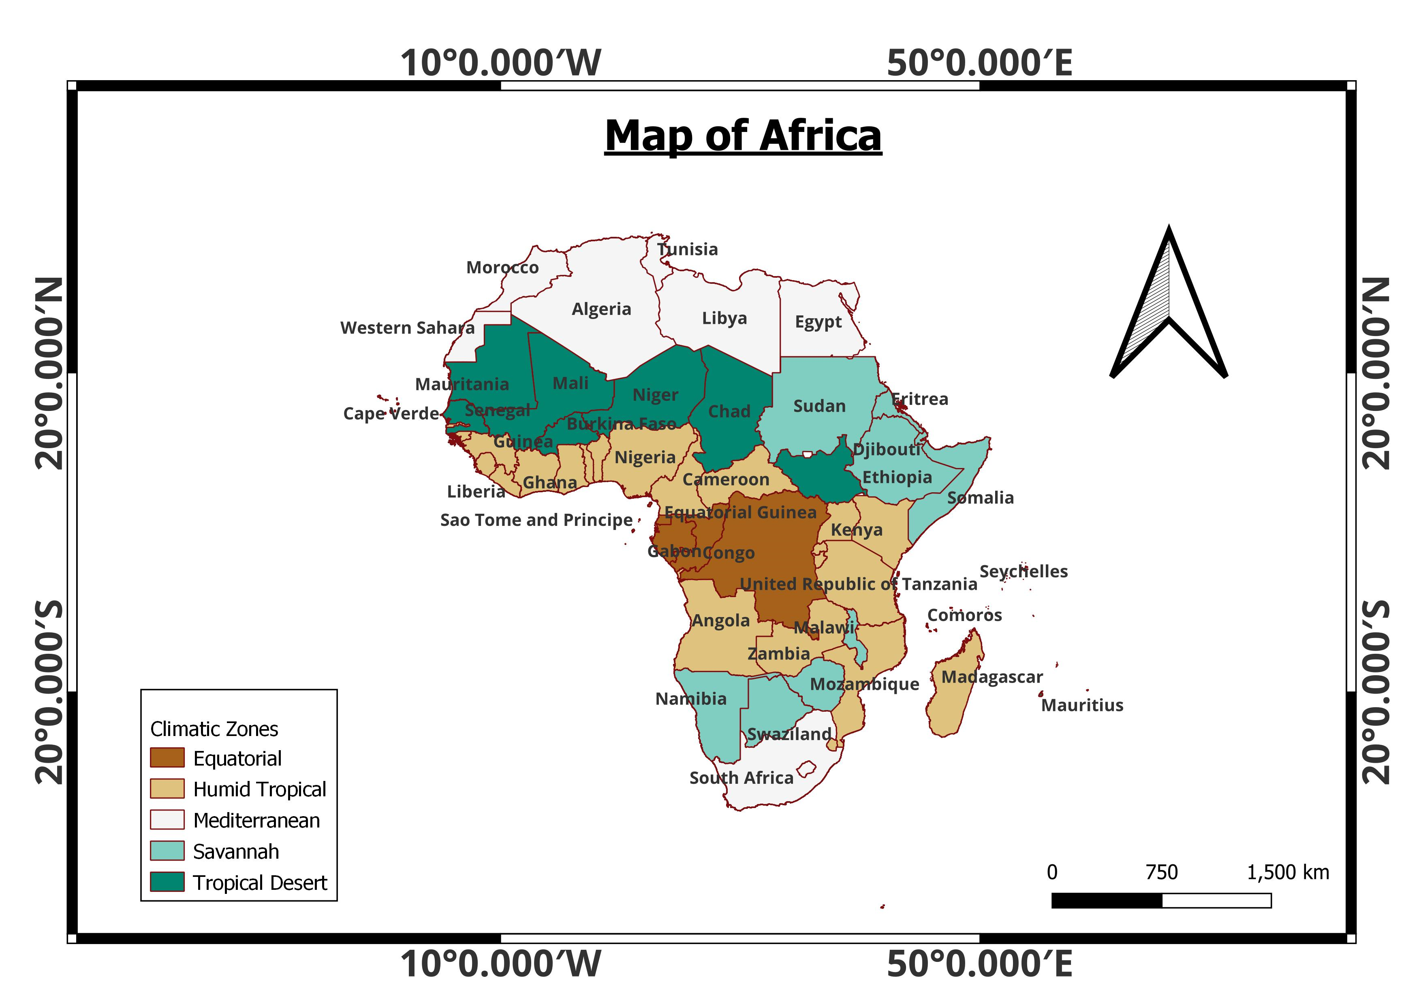
Study Area

Slide 8
Materials and Resources
Microsoft Office Suites
QGIS & ARCGIS
R and RStudio
Python and Jupyter IDE
Power BI and Tableau
SOFTWARE
8 years continuous GNSS Data from 31 IGS of Africa
Numerical Weather Forecast data(ERA5)
DATA USED
Notes:
Flowchart use is important here

Slide 9
Summary of Data Analysis
Time Series Modelling- AR, MA and SARIMA AND ARIMA
Stacked Ensemble Modelling
Prediction
Seasonal Analysis and Trend Analysis
Mann Kendall Analysis Trend
Stationarity Analysis.
Time Series Analysis
Entropy Analysis.
Clustering- Classification
Spatial Variability
Spatial Analysis
Notes:
Flowchart use is important here

Slide 10
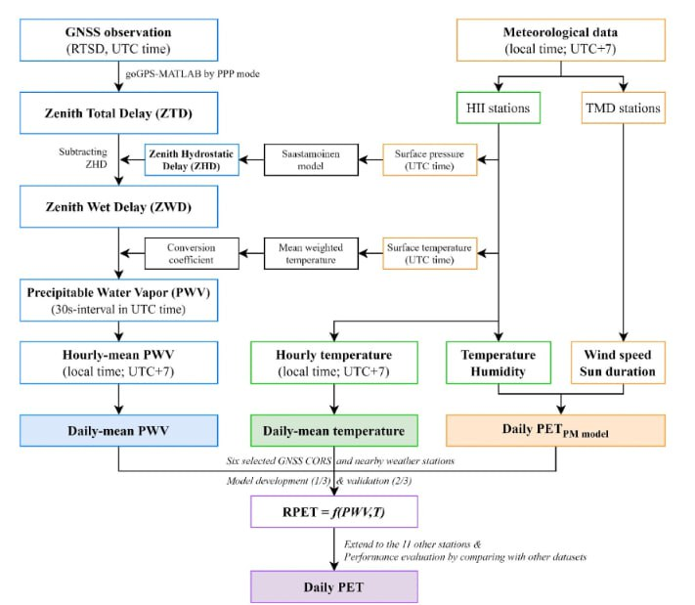
Methodology

Slide 11
RESULTS
ERA-5 and GNSS PWV show a positive correlation with a bias of 0.1859
The highest and least annual PWV values over all the selected IGS stations in Africa range from 54.66mm (2019) and 53.13mm and 7.94mm and 4.04mm(2021) respectively.
Station ADIS with the highest mean elevation of 2439.54m hast the minimum mean PWV value of 6.279mm, station with -37.08m elevation has PWV value of 39.77mm.
PWV value of 13.30mm is recorded at the highest latitude of 33.998⁰N and 36.91mm at the lowest latitude 34.425⁰S
The ensemble model has a good prediction accuracy with RMSE range between 0.20mm and 0.52mm as compared the base models with RMSE between 0.28mm and 17.65mm

Slide 12
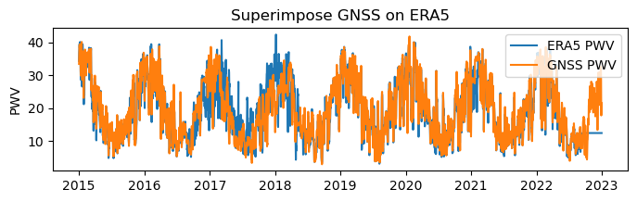
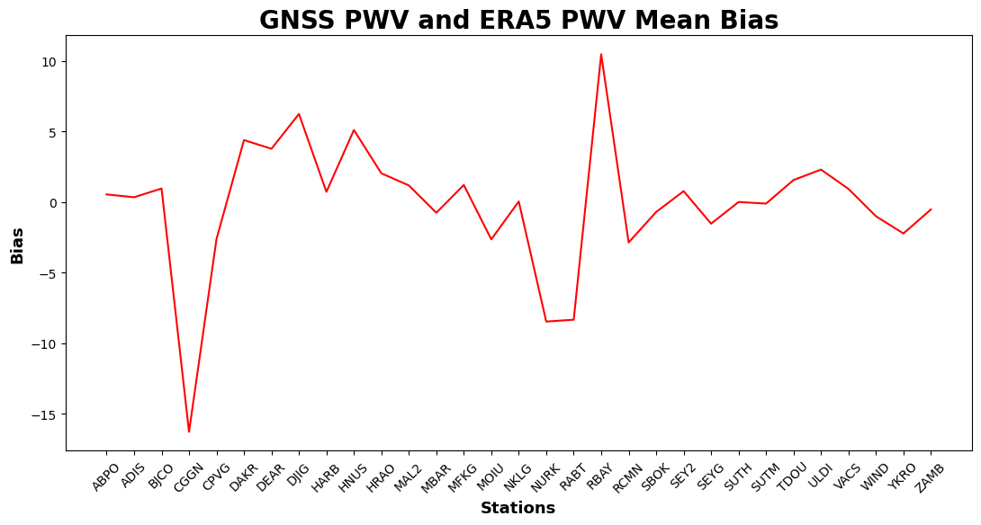
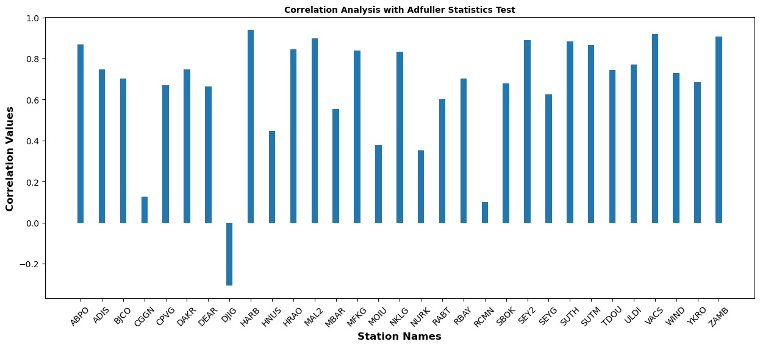
Correlation between ERA5 and GNSS PWV
Notes:
Flowchart use is important here

Slide 13
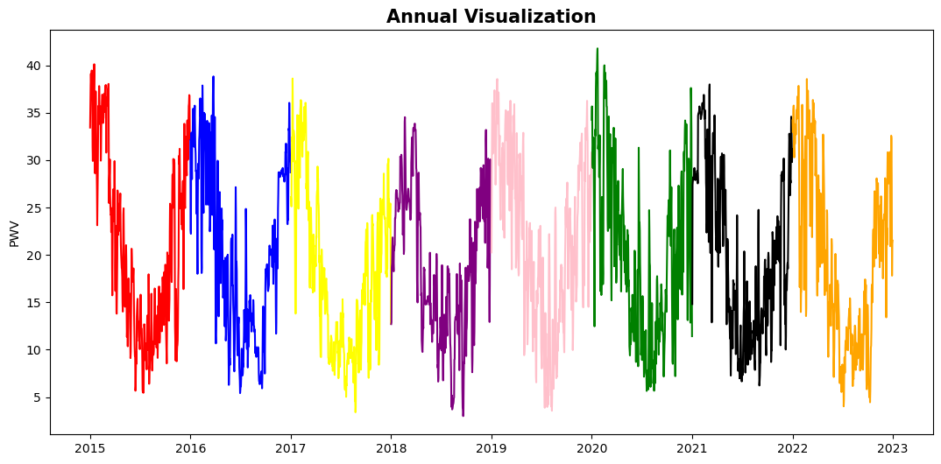
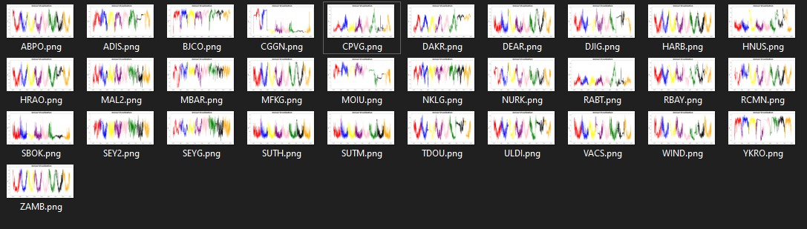
Exploratory Analysis with GNSS PWV
Notes:
Flowchart use is important here

Slide 14
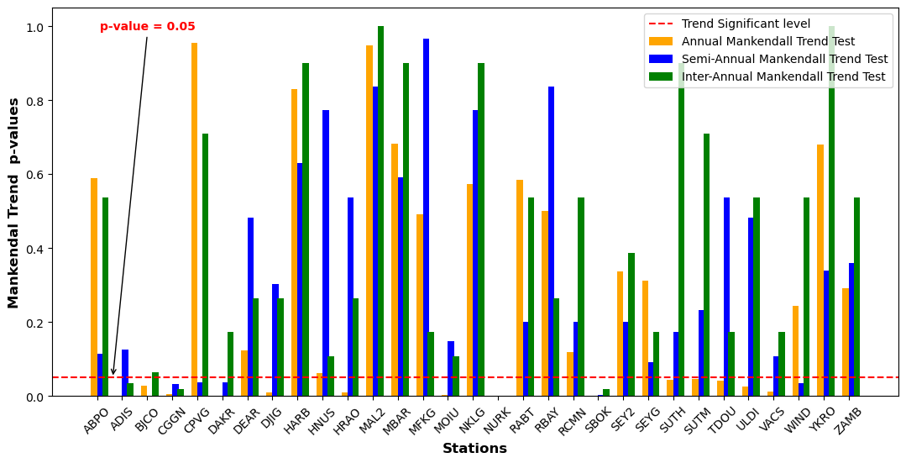
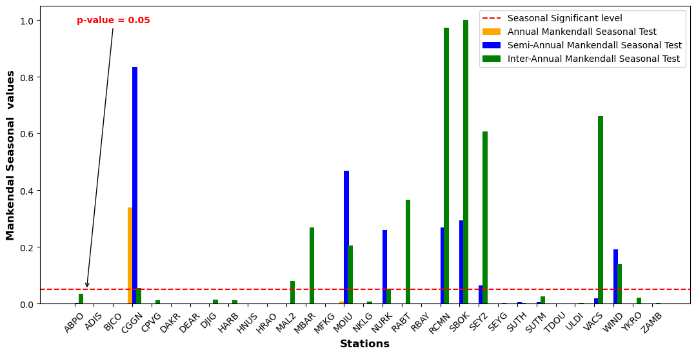
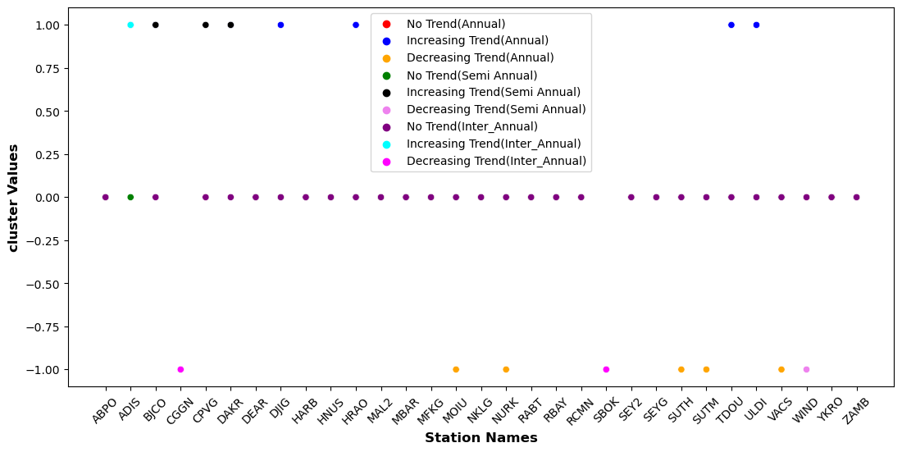
Trend and Seasonality Analysis-Mankendall Test
Notes:
Flowchart use is important here

Slide 15
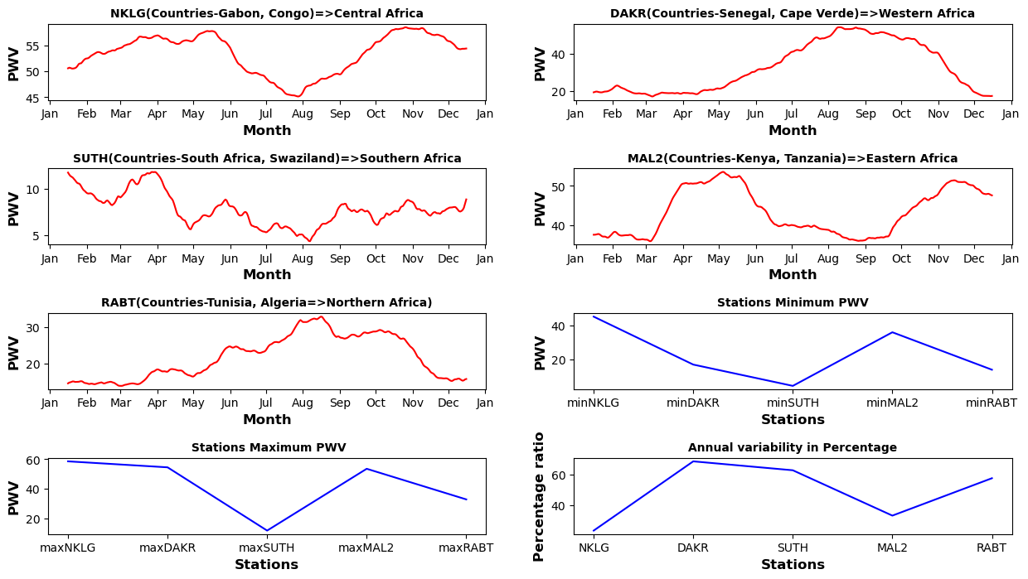
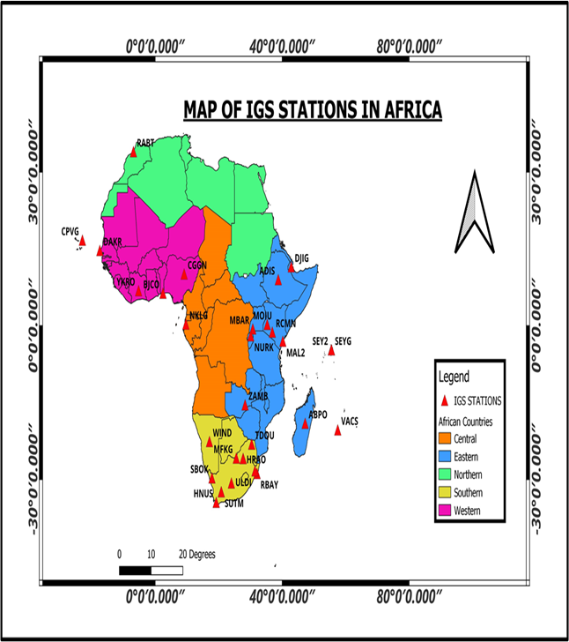
Trend and Seasonal Analysis
Notes:
Flowchart use is important here

Slide 16
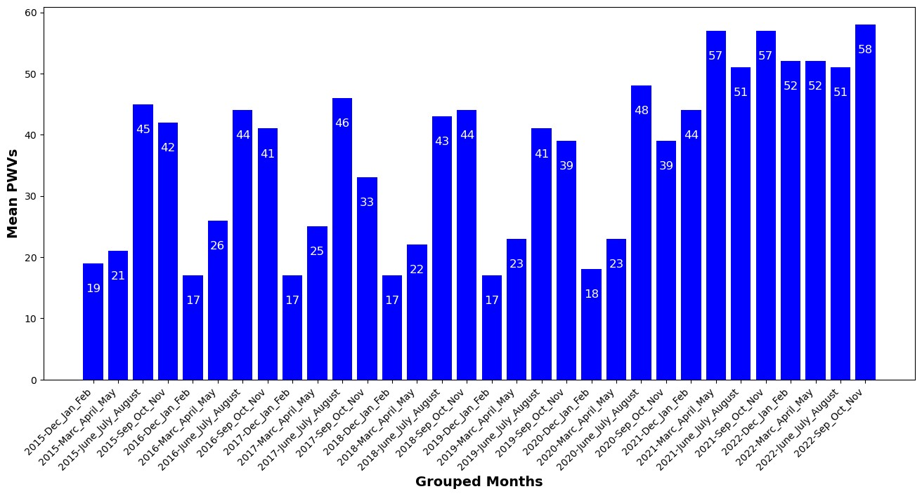
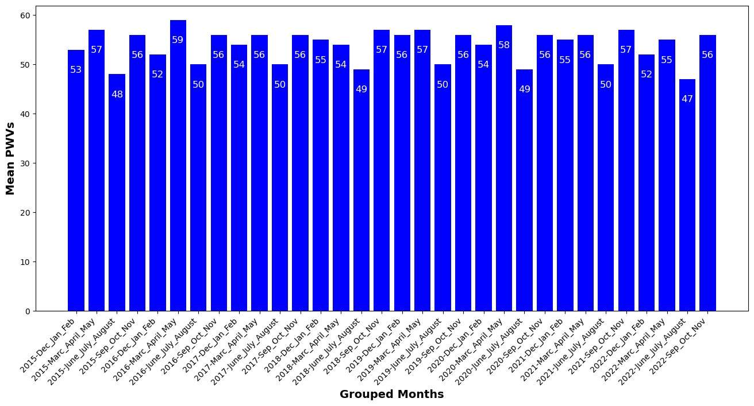
Trend and Seasonal Analysis
Notes:
Flowchart use is important here

Slide 17
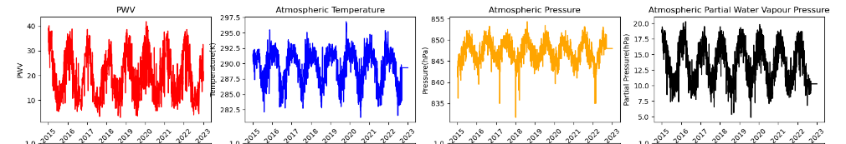
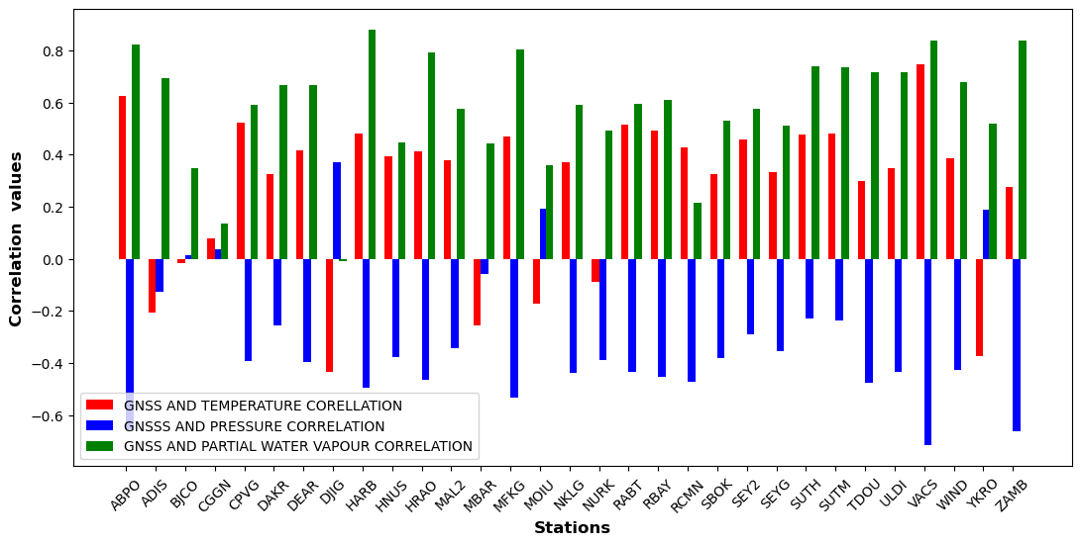
Correlation between GNSS PWV and Other Atmospheric Parameters
Notes:
Flowchart use is important here

Slide 18
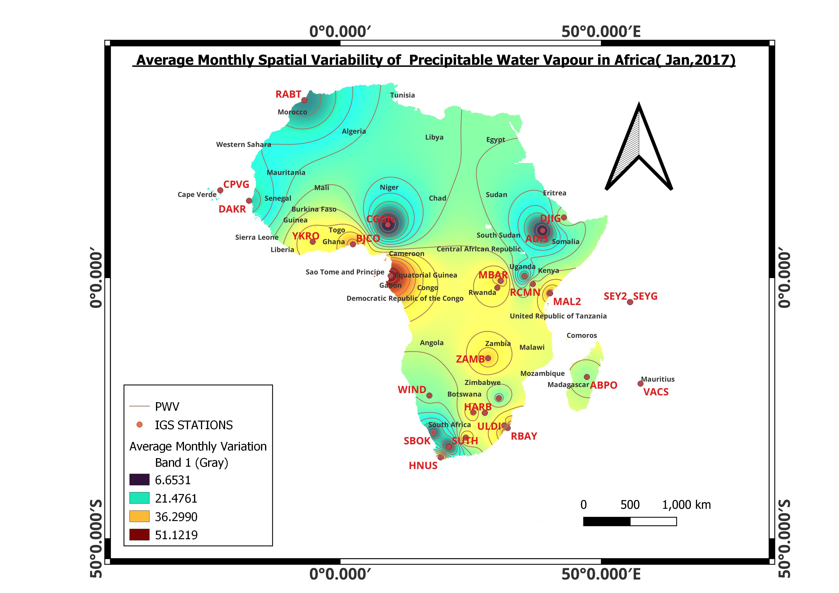
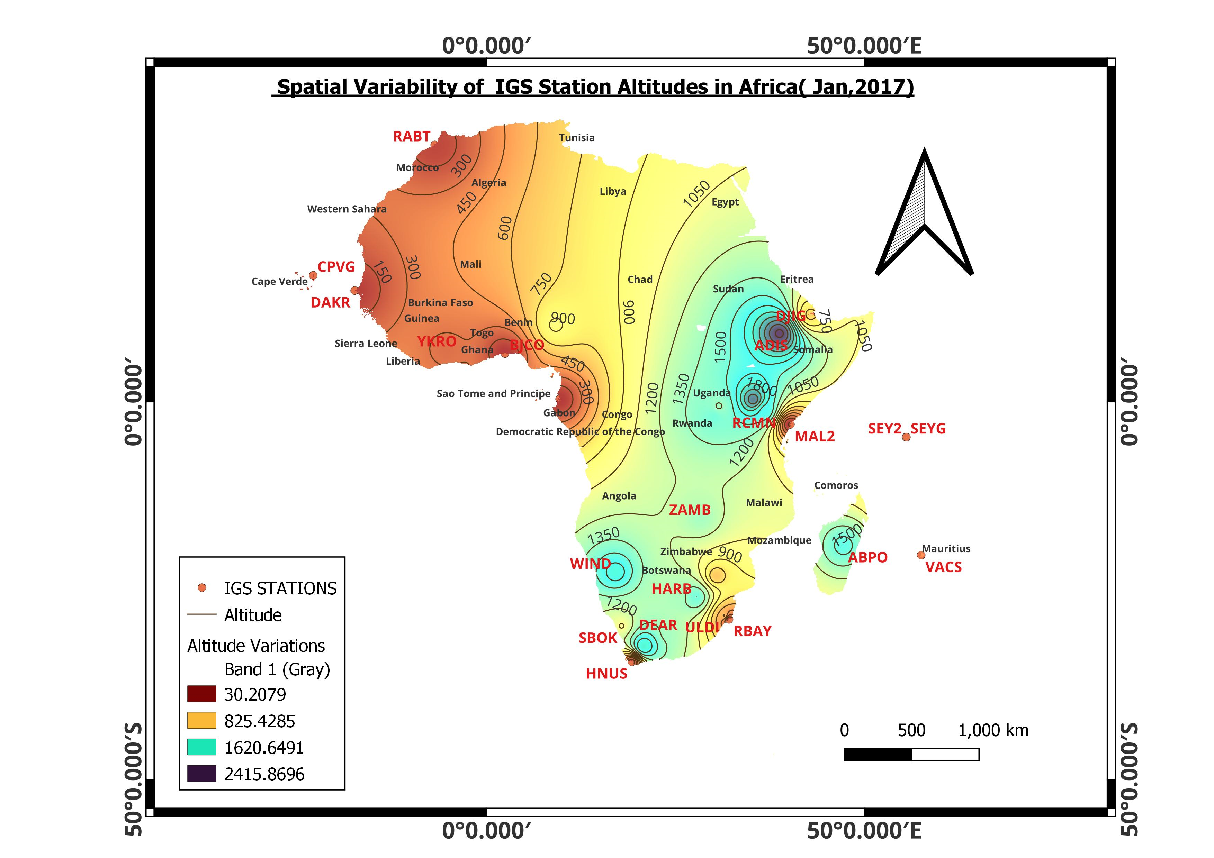
Spatial Variability of GNSS PWV
Notes:
Flowchart use is important here

Slide 19
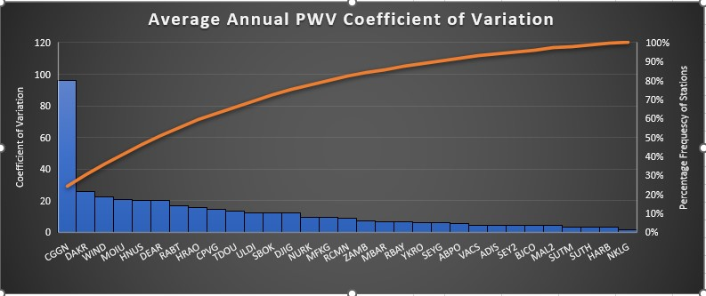
Cofficient of Variation-PWV Yearly Bias
Notes:
Flowchart use is important here

Slide 20
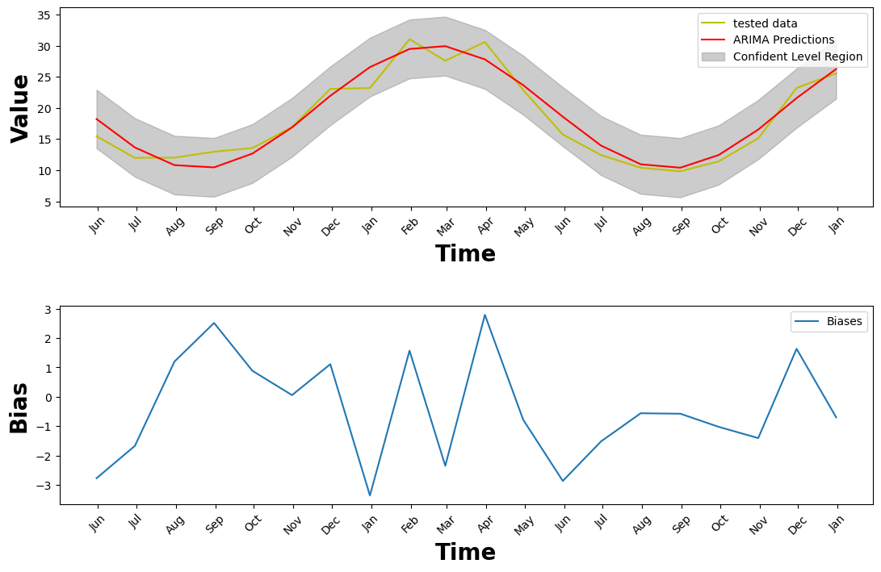
Prediction-Time Series Forecasting
Notes:
Flowchart use is important here

Slide 21
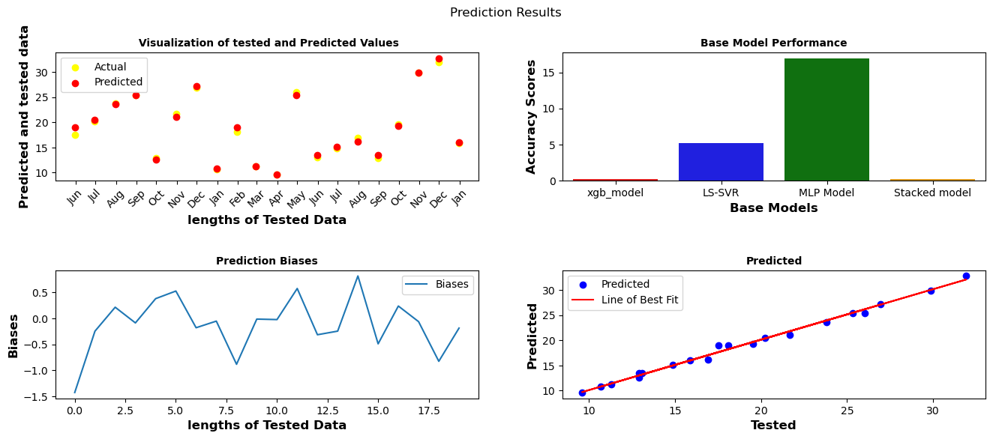
Prediction-Stacked Ensemble
Notes:
Flowchart use is important here

Slide 22
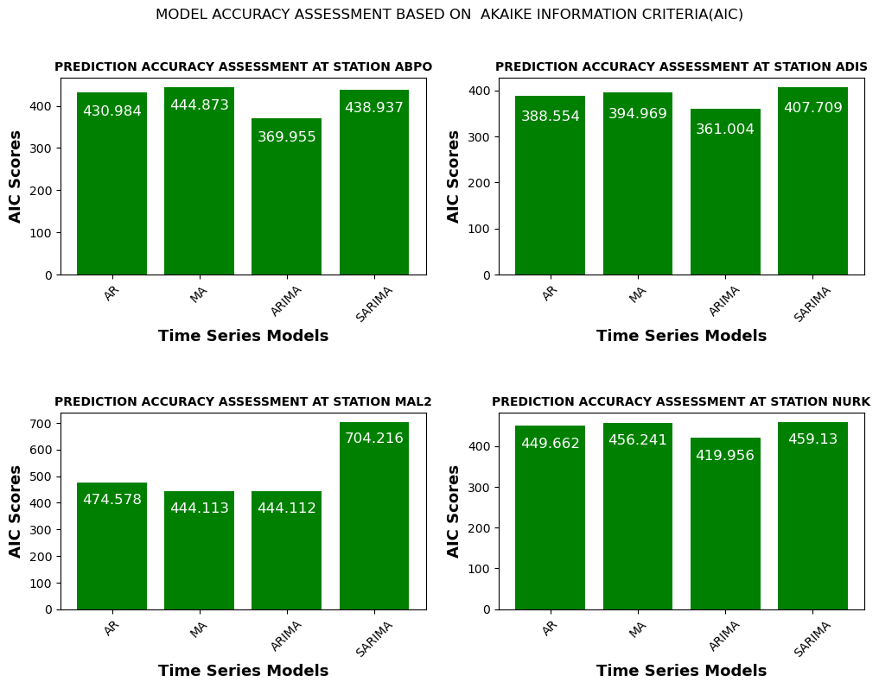
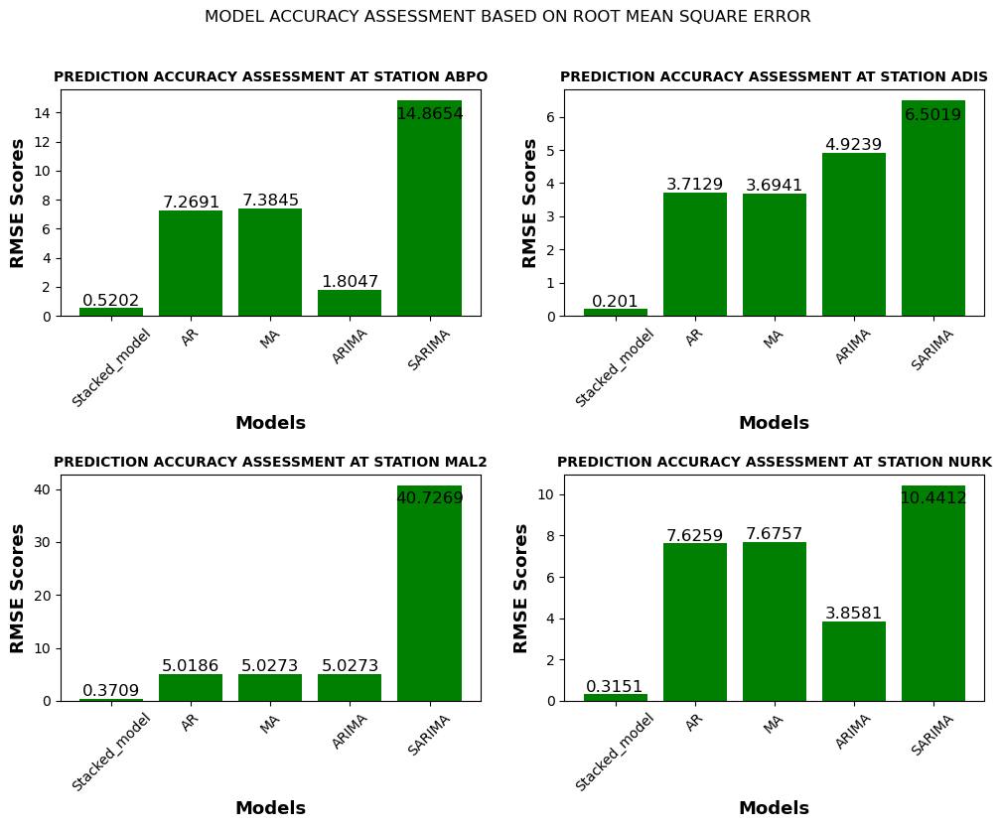
Prediction-Accuracy Performance Analysis
Notes:
Flowchart use is important here

Slide 23
Conclusion
Over all, PWV from ground based GNSS was analysed spatially and temporally over the selected IGS stations in Africa. An ensemble machine learning model was developed which can be used to predict PWV values in areas with missing IGS values if the need arises.
Notes:
Flowchart use is important here

Slide 24
Thank You!

